Slide 1
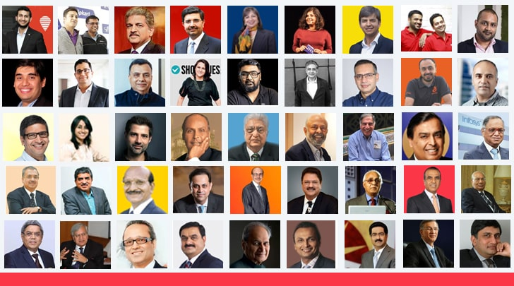

Slide 2
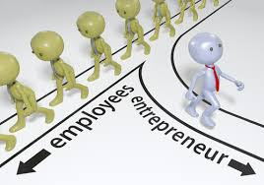
If You have confidence on own strength then you become entrepreneur,
But other have confidence on your strength then you become CEO.

Slide 3
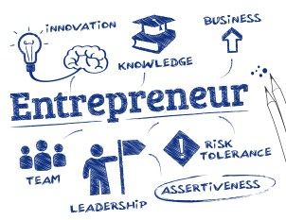
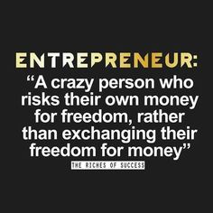

Slide 4
Concept
Enterprise
is an already formed business organization that propose some goods or services, etc.
Entrepreneur
is a person who establishes and manages the enterprise. He/she is often the founder and owner of the business.
Entrepreneurship
is the process of establishing new business enterprise along with the capacity to identify the opportunities and threats and to undertake all the risks to gain profits in results.

Slide 5
CONCEPT
It was the beginning of 18th Century when the word was used to refer to economic aspect
Richard Cantillon is the first one who introduced the term Entrepreneur with some economical aspect
According to him - “Entrepreneur as an agent who buy factors of production at certain price in order to combine them to produce product with a view to selling it in uncertain price in the future” (FARMER)
According to Knight - “Entrepreneur is the economic functionary who undertakes such responsibility of uncertainty which is not insured nor capitalized nor salaried”

Slide 6
THE CONCEPT OF ENTREPRENEUR
According to New Encyclopedia Britannica
“An entrepreneur is an individual who bear the risk of operating business in face of uncertainty about future condition”
According to Peter Drucker
“An entrepreneur is one who always searches for change, respond to it and exploit it as an opportunity. Innovation is a specific tools of an entrepreneur by which they can exploit change as an opportunity for different business and service”

Slide 7
DEFINITION

Slide 8
An individual who bears the risk of operating a business in the face of uncertainty about the future conditions. | Encyclopedia Britannica
He is the one who innovates, and introduces something new in the economy. | Joseph A. Schumpeter
He shifts economic resources out of an area of lower and into an area of higher productivity and greater yield. | J. B. Say (French economist)
He searches for change, responds to it and exploits opportunities. Innovation is the specific tool of an entrepreneur. | Peter F. Drucker
He is the one who is endowed with more than average capacities in the task of organising and coordinating the various factors of production. He is a pioneer and captain of industry. | Francis A. Walker
He is a critical factor in economic development and an integral part of economic transformation. | William Diamond
He is a person who is able to look at the environment, identify opportunities to improve the environment, marshall resources, and implement action to maximise those opportunities. | Robert E. Nelson

Slide 9
Why Should You Become an Entrepreneur?

Slide 10
You will be your own boss and boss to other people and make decisions that are crucial to the business’ success or failure.
You will have the chance to put your ideas into practice.
You will make money for yourself rather than for someone else.
You may participate in every aspect of running a business and learn and gain experience in a variety of disciplines.
You will have the chance to work directly with your customers.
You will have the personal satisfaction of creating and running a successful business.
You will be able to work in a field or area that you really enjoy.
You will have the chance to build retirement value (for example, by selling the business when you retire).

Slide 11
Scope of Entrepreneurship?

Slide 12
1. Contribution to GNP and per capita income:
Entrepreneurship contributes to economic stability by introducing new products
services in the market and encouraging effective resource mobilization.
This helps in increasing the gross national product as well as per capita income of the people in the country.
Economic stability leads to increased institutional investment for productive activities and is a sign of economic growth.
2. Employment generation:
Entrepreneurs are not only self-employed but also provide employment to others.
For example, when the information technology boom occurred in India, it led to several successful entrepreneurial ventures. This provided employment to many and also led to the launch of a number of engineering colleges, development of real-estate and hospitality ventures, and infrastructural facilities.

Slide 13
3. Balanced regional development:
The development of enterprises in less-developed regions promotes balanced regional development in the country.
Entrepreneurship stimulates the distribution of wealth and income to more and more individuals (such as stakeholders) and geographical areas, thus benefiting larger sections of society.
4. Promotion of export and trade:
Entrepreneurship promotes the country’s export trade and earns foreign exchange.
This earning can help combat the country’s import dues requirements. International trade brings economic strength and techno-economic reliance.
5. Improvement in the standard of living:
Entrepreneurs bring a wide variety of products and services into the market.
This increases competition in the market and makes it possible for people to avail of a better quality of products and services at lower and more competitive prices, resulting in an improvement of the country’s overall standard of living.

Slide 14
6. Increased innovation:
With the liberalization of the Indian economy, the increased competition in the domestic and international market has encouraged entrepreneurs to be more creative.
7. Overall development of the economy:
Entrepreneurs create new technologies, products, processes, and services that become the next wave of new industries, and these in turn drive the economy. Entrepreneurs are change agents in society. They create wealth and value, and generate employment in society. This naturally leads to social and economic growth.

Slide 15
Characteristics of an Entrepreneur

Slide 16
Mental ability
Clear objective
Business secrecy
Human relation ability
Communication ability
Technical knowledge
Motivator
Self-confidence
Long –term involvement
High energy level
Persistent problem solver
Initiative
Moderate risk-taker

Slide 17
Models of Entrepreneurship Development

Slide 18
Psychological Model
David McClelland’s theory
Hagen’s Theory of Withdrawal of Status Respect (1964)
Rotter- Internal–External Locus of Control Theory
Sociological Model
Max Weber’s Theory of Religious Beliefs
Hozelist’s Sociocultural Theory
Thomas Cochran’s Theory of Entrepreneurial Supply
Frank W. Young’s Theory of Group Level Pattern
Integrated Model

Slide 19
1. Psychological Models
The essence of psychological theory is an understanding of the difference in individuals’ attitudes.
According to this theory, the internal attitude and ability to judge and forecast any situation lead a person to become a successful entrepreneur.

Slide 20
David McClelland’s theory of Achievement motivation
In his theory, McClelland considers entrepreneurs as people who do things in a better way and make decisions in times of uncertainty.
Motivation is an important determinant for entrepreneurial growth.
Three motives for accomplishing things:
Need for Power (nP), or the drive to influence others and any given situation.
Need for Affiliation (nAff), or the drive for interpersonal relationship.
Need for Achievement (nAch), or the drive to excel, advance, and grow.
All of these needs may simultaneously act on an individuals.
Notes:
According to the McClelland, people who have high need for achievement have tendency to win and excel. People who have high need for achievement personally take the responsibility of solving problems and will always try to be better than others. He further explained that people with high need of achievement are more likely to succeed as entrepreneur because it is the need for achievement that motivates and promotes entrepreneurship.
The definite characteristics of a high achiever (entrepreneur) can be listed as follows:
(i) They lay down moderate realistic and achievable goals for them.
(ii) They take planned risks.
(iii) They favor situations wherein they can get individual responsibility for solving problems.
(iv) They need actual feedback on how well they are doing.
(v) Their need for achievement live not only for the sake of economic rewards or social recognition rather personal achievement is essentially more satisfying to them.

Slide 21
Hagen’s Theory of Withdrawal of Status Respect (1964)
Everett Hagen’s concept of the entrepreneur is that of a “creative personality” interested in accelerating change and driven by a motivation to achieve.
According to Hagen, entrepreneurial growth has been very gradual and may or may not even occur in the same generation. In his theory of withdrawal of status respect,
Everett Hagen’s argument is that certain social changes may disrupt the stability of traditional society and cause psychological changes in a group or in an individual.
Notes:
It occurs when the member in the group perceive that their efforts and purposes in the life are not valued by the other members. He proposed four events which can lead to status withdrawal:
Displacement of a conventional best group from its earlier status by another conventional supply physical force.
Defamation of valued symbols through some change in the attitude of the superior group
Inconsistency of status symbols with a changing‟ distribution of economic power.
Acceptance of expected status on migration to a new society.

Slide 22
Rotter- Internal–External Locus of Control Theory
Professor J. D. Rotter of Ohio University introduced the Internal–External Locus of Control Theory, which highlights the self-confidence of a person, and the dependency on fortune and external environment for becoming an entrepreneur.
According to this theory, the internal locus of control comprises self-confidence, extreme belief in one’s own ability, and initiatives taken by an individual.
Locus of control determines whether a person perceives a potential goal to be attainable through one’s own actions (internal locus of control) or through uncontrollable external factors (external locus of control).

Slide 23
Sociological Model
Max Weber’s Theory of Religious Beliefs
Hozelist’s Sociocultural Theory
Thomas Cochran’s Theory of Entrepreneurial Supply
Frank W. Young’s Theory of Group Level Pattern

Slide 24
2. Sociological Model
Social cultures to be the driving force behind entrepreneurship.
The entrepreneur becomes a role performer in conformity with the role expectations of society.
Such role expectations are based on religious beliefs, taboos, and customs.

Slide 25
Max Weber’s Theory of Religious Beliefs
According to Max Weber, religious beliefs are the driving or restraining forces for entrepreneurial activity.
Religious beliefs play a crucial role in determining the attitude of the entrepreneur towards generating or limiting profits.
Weber took the position that entrepreneurial growth is dependent upon the ethical values (due to religion) of society.
Capitalism thrives under the Protestant work ethic that advocates hard work, honesty, and discipline. The spirit of capitalism, coupled with the motive of profit, results in the creation of a large number of successful business enterprises.
Weber distinguished between the “spirit of capitalism” and the “adventurous spirit.” The spirit of capitalism is influenced by a strict discipline, whereas the adventurous spirit comes from the free force of impulse.
Right combination of discipline and impulse defines the successful entrepreneur.
Notes:
ax Weber believes that religion has a large impact on the entrepreneurial development of the country because some religion has basic faith to earn more money whereas some has less. He calls them „spirit of capitalism‟ which can be enhanced in the country if there will be favourable attitude towards capitalism in the country. It is the religious beliefs that develop the sense of capitalism in the individual which generates the feeling of occupational chase and the addition of assets.

Slide 26
Hozelist’s Sociocultural Theory
According to Hozelist, a specific social culture leads to growth in entrepreneurship.
Social sanctions, cultural values, and role expectations are responsible for the emergence of entrepreneurship.
Entrepreneurship grows in societies that permit variability in choice of paths of life and non-standard socialization of individuals.

Slide 27
Thomas Cochran’s Theory of Entrepreneurial Supply
In agreement with Hozelist, believed that the environment in which an individual is brought up determines his entrepreneurial urge.
According to him, the supply of entrepreneurs in society needs to be seen with reference to prevailing child-rearing practices.
He stated that the performance of the entrepreneur might be seen in reference to his own attitudes towards an occupation.
Values and role expectations of the particular social group to which he belongs are the most important determinants in the performance of business entrepreneurial roles.

Slide 28
Frank W. Young’s Theory of Group Level Pattern
This is one of change based upon society’s incorporation of relative sub-groups within society.
Group can be reactive in two ways: if the group experiences low status recognition and denial of access to important social networks, other with the greater access.
A group without anything will compete with other groups and also try to acquire societal recognition.
Low status group will lead to entrepreneurial behaviour if the group has better institutional resources than others in that society level.
Young’s model of entrepreneurship suggests the creation of supporting institutions in society, such as the family, as the determinant of entrepreneurship.

Slide 29
3. Integrated Models
In search of an integrated approach, the behaviorists tried to synthesize psychology and sociology to explain entrepreneurship.
According to T.V. Raos, the optimal presence of the following factors, leads to the initiation of entrepreneurship.
Need for motive
Long term involvement in thought and action to achieve the goal in entrepreneurial activity.
Personal, social and material resources favorable to entrepreneurial activity.
Suitable sociopolitical System for the establishment, development, and expansion of an enterprise.

Slide 30
INTRODUCTION TO ENTREPRENEUR AND PROFESSIONAL MANAGERS

Slide 31
Functions of Entrepreneur and Manager in managing organization
Planning
Organizing
Staffing
Directing
Controlling

Slide 32
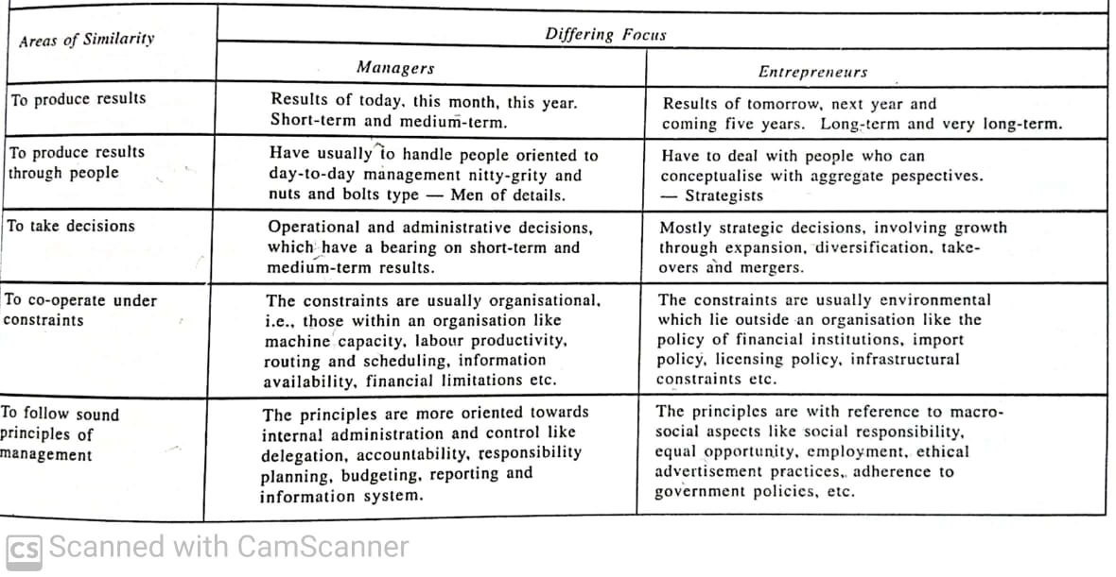
Managers and Entrepreneurs (Similarities)

Slide 33
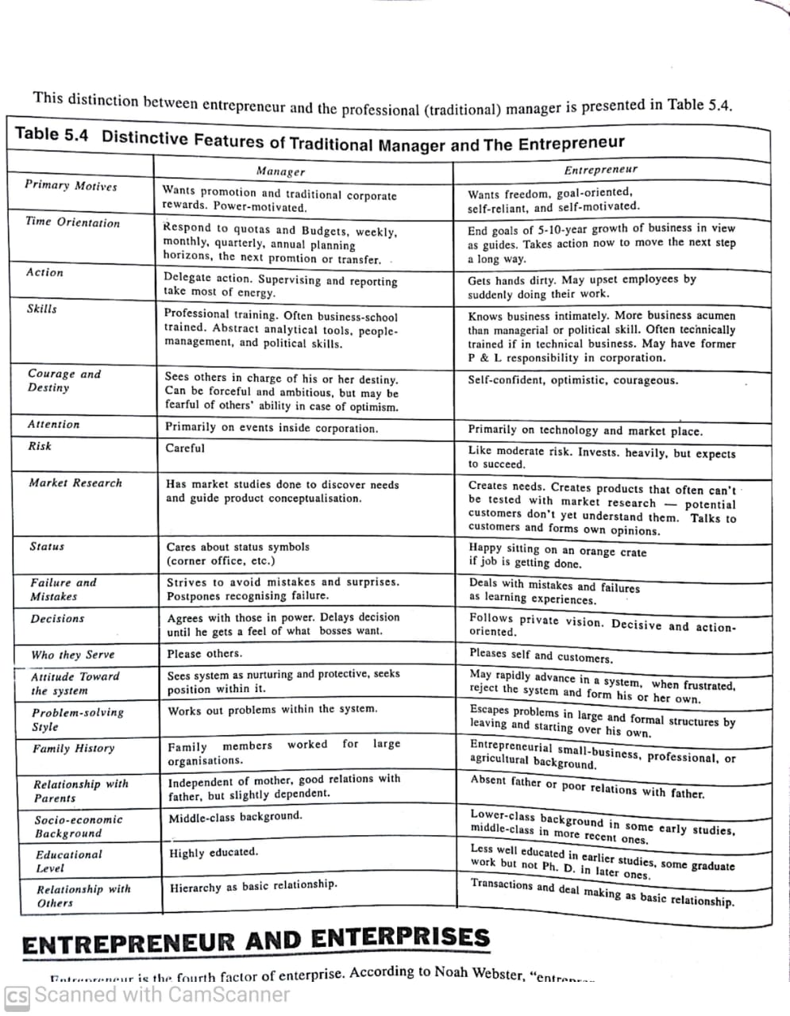
Managers Vs Entrepreneurs

Slide 34
Managers Vs Entrepreneurs

Slide 35
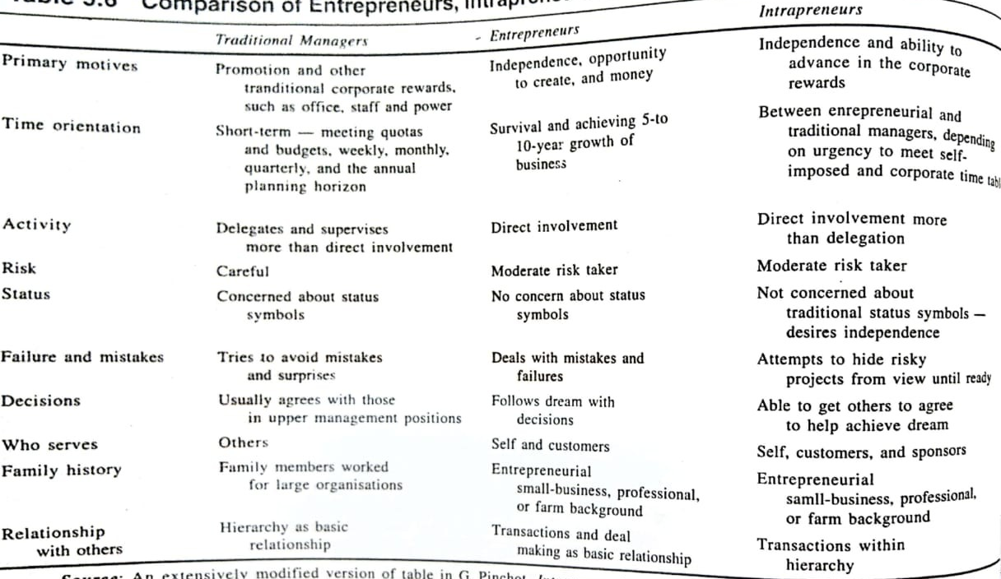
Comparison

Slide 36
CLASSIFICATION OF ENTREPRENEURS

Slide 37
According to type of business
Business entrepreneur
Trading entrepreneur
Industrial entrepreneur
Corporate entrepreneur
Agricultural entrepreneur

Slide 38
According to use of technology
Technical entrepreneur
Non-technical entrepreneur
Professional entrepreneur

Slide 39
According to motivation
Pure entrepreneur
Induced entrepreneur
Motivated entrepreneur
Spontaneous entrepreneur

Slide 40
Classification of entrepreneurs
Acc. to the type of business
Business entrepreneurs
Trading entrepreneurs
These entrepreneurs are associated only with trading activities. They do not engage themselves with the manufacturing work. They undertake wholesale or retail trading activities.
Industrial entrepreneurs
These entrepreneurs are associated with the manufacturing process and industrial activities. These entrepreneurs may be involved in any large scale, medium scale or small scale industries.
Notes:
(

Slide 41
Corporate entrepreneurs
These entrepreneurs promote and establish corporate empires. They are successful at initiating and running corporate companies.
Agricultural entrepreneurs
Agricultural entrepreneurs are the entrepreneurs involved in agricultural and allied activities. They can also be engaged in horticulture, floriculture, sericulture, apiculture, animal husbandry, dairy farming etc.
Notes:
Gramophone works with farmers and provides them agronomy services and right inputs during the entire cropping cycle, at their doorstep.)

Slide 42
Classification of entrepreneurs
Acc. to the use of technology
Technical entrepreneurs
These entrepreneurs are technically sound and trained. They use their technical skills in establishing manufacturing units and improving the manufacturing units with latest level of technology. They highly influence the production technique in vogue.
Non-technical entrepreneurs
These entrepreneurs are remotely concerned with the technical aspects of the entrepreneurship. They focus on evolving alternative strategies of marketing and distribution in order to promote their business.
Notes:
The founder and chairman of Bose Corp, Amar Bose passed away earlier this month. A graduate student from Massachusetts Institute of Technology (MIT), Bose was associated with the premiere tech school through his life. As a PhD student, and later as a professor and then professor emeritus, the idea of Bose Corp, set up in 1964, stemmed from his disappointment with the speakers in a stereo system that he bought as an MIT student that was the trigger for setting up Bose Corp in 1964. Bose Corp has, over the years, used the entrepreneur’s innovative research for some of the best known sound systems in the world. Furthering his company’s thought process, the entrepreneur was involved with many of the products that were seen in Bose’s stable, which included noise-canceling headphones as well as audio systems for cars.
McDonalds, Wenky's, Pizza Hut, Starbucks, Kelly Services, Zoom car- Rent A Car, Metropolitan Life Insurance

Slide 43
Professional entrepreneurs
These entrepreneurs have keen interest in establishing business enterprises. However, once the enterprises are established the professional entrepreneurs sell out the existing enterprises and move out to start new enterprises. They never cling to the enterprises established by them.
Notes:
WhatsApp was founded by Jan Koum and Brian Acton who had previously spent 20 years combined at Yahoo. WhatsApp joined Facebook in 2014
Kishore Biyani sold Big Bazaar, Central, Brand Factory, and Pentaloons etc to Reliance Ind. And Aditya Birla group.

Slide 44
Classification of entrepreneurs
Acc. to motivation
Pure entrepreneurs
They are guided by the profit motive. The economic goals drive these entrepreneurs to undertake business activities. They have faith in their own performance.
Spontaneous entrepreneurs
Spontaneous entrepreneurs have the inherent urge and aptitude to become entrepreneurs. They have intrinsic passion to set up their own enterprises and pursue their entrepreneurial pursuits.
Notes:
Example of sidhdharth
Case of bewakoof.com

Slide 45
Induced entrepreneurs
These entrepreneurs are induced to pursue entrepreneurial pursuits. There are various government agencies or NGOs who induce people to undertake entrepreneurial activities. The government also provides incentives, subsides, tax exemptions, financial and technical assistance in order to induce persons to become entrepreneurs. Skill training and EDPs are conducted to generate entrepreneurial spirit among the persons.

Slide 46
Classification of entrepreneurs
Acc. to growth
Growth entrepreneurs
He necessarily takes up high growth industry which has sustained growth prospects.
Super growth entrepreneurs
These entrepreneurs have shown enormous growth in their venture by the liquidity of fund, profitability and gearing.
Notes:
It based, healthcare, jio

Slide 47
Classification of entrepreneurs
Acc. to stages of development
First-generation entrepreneurs
These entrepreneurs had not inherited any family business. They had established their own enterprises. They are self-made and lack any previous entrepreneurial experiences.
Second-generation entrepreneurs
Second generation entrepreneur are those entrepreneurs who inherit the family business firms and pass it from one generation to another.

Slide 48
Modern entrepreneurs
A modern entrepreneur is one who undertakes those ventures which go well along with the changing demand in the market(which suits the current market needs).
Classical entrepreneurs
A classical entrepreneur is a stereotype entrepreneur whose aim is to maximize his economic returns at a level consistent with the survival of the unit but with or without an element of growth.

Slide 49
Classification of entrepreneurs
Others
Social entrepreneurs
Entrepreneurs are innovative highly motivated and creative thinkers. When these attributes are combined with the drive to solve social problems, a ‘social entrepreneur’ is born. Thus, social entrepreneurs are individuals with innovative solutions to society’s most pressing and daunting social problems.
Notes:
For instance, when Bill Gates (who is one of the richest persons in the world) initiates philanthropic activities through his charitable foundation 'The Gates Foundation' such acts are claimed as social entrepreneurial because Bill Gates is also a social entrepreneur.
Through Tesla Motors, SolarCity, and SpaceX, Musk has become a pioneer of social entrepreneurship in the modern age, as he seeks to build accessible solutions to renewable energy and push the limits on space exploration for mankind.
Sanjit “Bunker” Roy had a privileged upbringing in India, in contrast to many Indians who live off of less than $1 per day. When Roy visited some of his country's rural villages, he had a life-altering experience and decided to find a way to improve the social-economic inequities in his country. He founded Barefoot College in 1972, a solar-powered college for the poor.
As co-founder and global ambassador of the Malala Fund, Shiza Shahid, manages business operations for Malala Yousafzai, the teenager who became the youngest winner of the Nobel Peace Prize in 2014.⁴﻿ Like Malala, Shahid was born in Pakistan. She initially reached out to Malala in 2009 and worked to organize a camp for her and other Pakistani girls. In 2012, Shiza flew to Malala's bedside after she was targeted and shot by the Taliban for promoting education for girls. Inspired by Malala's desire to continue campaigning for gender equality and education, Shahid decided to help Malala strategize her campaign. Shahid created the Malala Fund, which helps empower women and girls by advocating and spreading access to education.

Slide 50
Women entrepreneurs
Women entrepreneurs may be defined as the women or a group of women who initiate, organize and operate a business enterprise.
As the name of this type of entrepreneur suggests, it involves women at the forefront of entrepreneurship. Shri Mahila Griha Udyog Lijjat Papad is one such organization. They pride themselves in being a women’s organization —of the women, by the women, and for the women. It was started in 1959 with seven lady members with a borrowed sum of Rs.80 at Girgaum in Mumbai. Another typical example of this type of entrepreneur is Kiran Majumdar Shaw, whose entrepreneurial endeavour has been detailed out in a caselet.

Slide 51
Innovating entrepreneurs
He is one who introduces new goods, inaugurates new method of production, discovers new market and reorganises the enterprise. It is important to note that such entrepreneurs can work only when a certain level of development is already achieved and people look forward to change and improvement.
Notes:
saregama

Slide 52
Adaptive/Imitating entrepreneurs
There are characterised by readiness to adopt successful innovations inaugurated by innovating entrepreneurs. Imitative entrepreneurs do not innovate the changes themselves, they only imitate techniques and technology innovated by others.
Such types of entrepreneurs are particularly suitable for the under-developed regions for bringing a mushroom drive of imitation of new combinations of factors of production already available in developed regions.
Notes:
motorola.,xiomi, oppo, bluetooth speakers

Slide 53
Fabian entrepreneurs
They are characterised by very great caution in experimenting any change in their enterprise. They imitate only when it becomes perfectly clear that failure to do so would result in a loss of the relative position in the enterprise.
Drone entrepreneurs
These are characterised by a refusal to adopt opportunities to make changes in production formula even at the cost of severely reduced returns relative to other like producers. Such entrepreneurs may ever suffer losses but they are not ready to make changes in their existing production methods.
Aspiring entrepreneurs
Notes:
Indian rural agricultural entrepreneurs
Jewellery business

Slide 54
Family-Business Entrepreneur
Family-business entrepreneurs are the followers of family tradition role models. A typical example is that of Aditya Vikram Birla (1944-1995), who created about 75 factories for his business group in a career span of 25 years. Aditya Birla was the son of industrialist Basant Kumar Birla (popularly known as BK). His group is now known after him (Aditya Birla Group) and managed by his son Kumar Mangalam Birla.
Lifestyle entrepreneurs
These entrepreneurs take business as an integral part of their life. Usually, the family enterprise and business.

Slide 55
Opportunist entrepreneurs
As the name suggests, this kind of entrepreneur is an individual who has identified a technology-based opportunity and, while initiating and managing a small technology-based venture, either has little or no technical experience or whose previous occupational experience was within non-technical organizations.
For example, Azim Hasham Premji inherited Wipro from his father, who was into oil business. Later, Premji realized the potential of information technology and ventured into this business. Rest is history as Wipro is today known as one of India’s IT powerhouses.

Slide 56
E- entrepreneurs
Mompreneures
Professor entrepreneurs
IT Entrepreneurs
Intrapreneur

